Slide 1


Slide 2


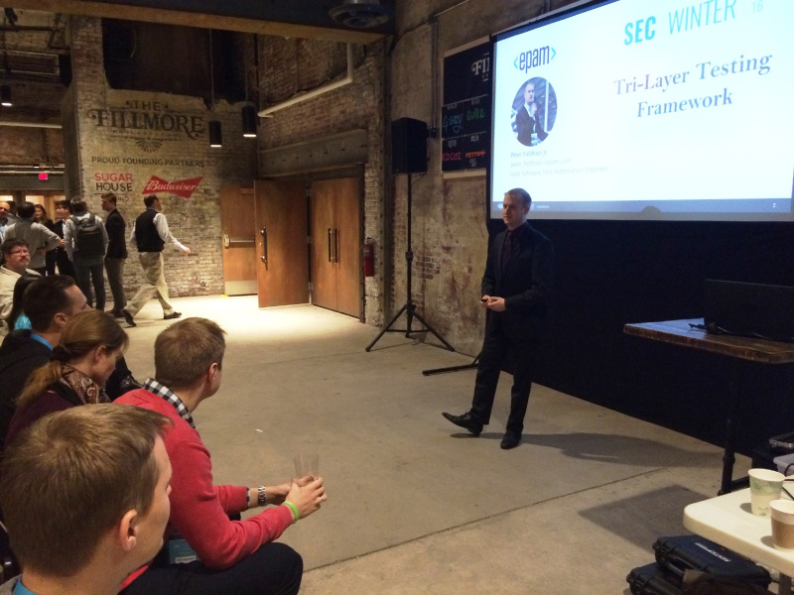




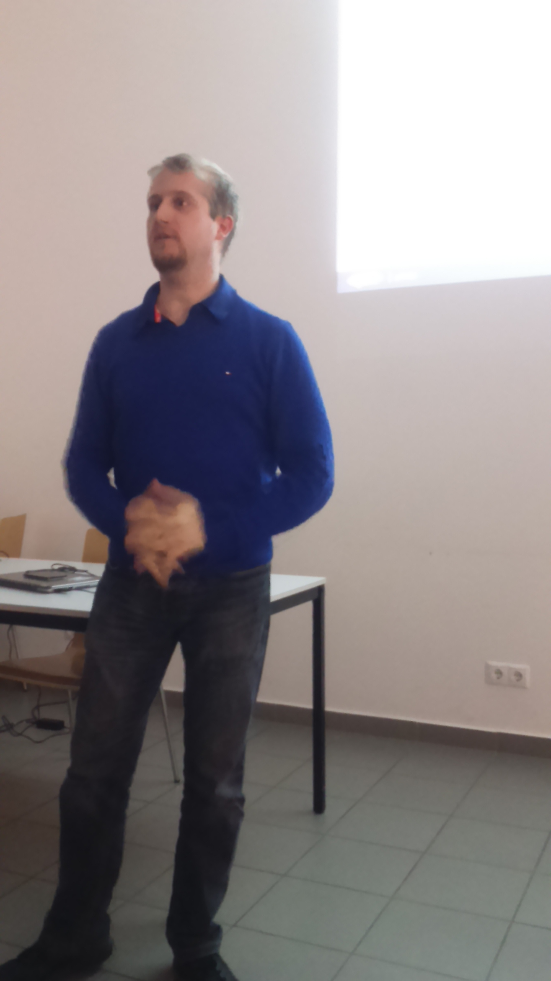
Tri-Layer Testing Framework
Péter Földházi Jr.
peter_foldhazi@epam.com
Lead Software Test Automation Engineer

Slide 3








Table of Contents
Test Automation Basics
Legacy Layering Techniques
Tri-Layer Framework
Flow Model Pattern

Slide 4
TEST
1. Test Automation Basics
AUTOMATION
BASICS

Slide 5
Test Automation Basics
Processing Acceptance Criteria For Automation
REQUIREMENTS RECEIVED
SELECT CASES TO AUTOMATE
SORT OUT BY PRIORITY
MERGE COHERENT CASES
CREATE TEST CASES
ANALYSIS
DESIGN
IMPLEMENTATION
Business
Manual Testers
Automation Testers

Slide 6
Test Automation Basics
What shall not be automated?
SELECT CASES TO AUTOMATE
Technical difficulties
Resource shortage
Better manually
Limitation of access
Imaging
3rd party tool
Lack of mocks
Not enough engineers
Maintenance cost is too high
Look & Feel
Layout
Colouring & schemes

Slide 7
Test Automation Basics
Merging Test Cases
MERGE COHERENT CASES
Log in with a regular user
Failed changing user’s password
Successfully change password
Log out
Log in and verify password change functionality

Slide 8
legacy
2. Legacy Layering Techniques
layering
techniques

Slide 9

Legacy Layering Techniques
The Big Mess
No separate layers
No design at all
Focus is on dirty and quick solution
POCs (Proof of Concepts)
No automation effort

Slide 10

Legacy Layering Techniques
The Two Layer Framework
Commonly used
Circumstantial reusability
Separate libraries
Test layer
Test #1
Test #2
Test #N
Test Libraries layer
POM
BDD
Hw Cont

Slide 11
Tri
3. Tri-Layer Framework
Layer
framework

Slide 12

Tri-Layer Framework
A Testing Framework’s Purpose
Automated testing
Generated reports
Detailed logs
Extend the knowledge of the base tool
Decrease maintenance cost

Slide 13
Tri-Layer Framework
Facade Pattern
Simplified interface to a larger body of code
Software library easier to use
Library more readable
Reduce dependencies
Wrap a poorly designed collection of APIs
Inter layer
Main Screen
Login Screen
Profile Screen
Test layer
Login Flow
Test Successful Login
Test Failed Login
Test Edit Profile
Facade

Slide 14
Tri-Layer Framework
Framework Layers
Test layer
Test #1
Test #2
Test #N
Inter layer
Flow Models
Structure Models
Core layer
Base Test
Project Common Library
Additional Libraries

Slide 15
Tri-Layer Framework
Framework Layers
BaseTest:
No application dependency
Basic functionality with base tool
Any project may use it
Common:
Project dependent
Domain specific functionality
Only project related apps may use it
Additional libraries:
Solution dependent
Solution specific functionality
Example: sensor mocks, parsers, loggers etc.
Core layer
Base Test
Project Common Library
Additional Libraries

Slide 16
Tri-Layer Framework
Framework Layers
Structure Models:
Each screen has their own dedicated model
Only element locators and screen specific properties are stored in these models
No user actions are to be implemented!
Flow Models:
The service provider facades
Test scripts call all the methods from these models as the test steps
All user flows are stored in these models
Inter layer
Flow Models
Structure Models

Slide 17
Tri-Layer Framework
Framework Layers
Test scripts:
Runnable test scripts
Implementations of all the ”ready-to-automate” processed test cases
Each test step shall directly be called from facades provided by the flow models
Test layer
Test #1
Test #2
Test #N

Slide 18

FLOW
4. Flow Model Pattern
MODEL
PATTERN

Slide 19
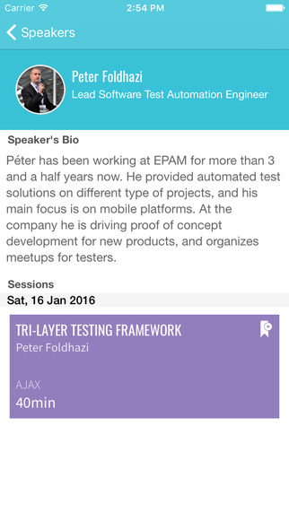
Flow Model Pattern
Page Object Model
UI areas that your tests interact with
Modeled as objects within the test code
Separate page models
Both structure and user interactions are stored in the same class
Reduces duplicated code
Buttons | Textfields | Edittexts | Images | Pickers...

Slide 20
Flow Model Pattern
Flow Model Design
- Click Username Edittext
- Type Username
- Click Password Edittext
- Type Password
Click Login Button
Main Screen
Login Screen
Click Back Button
UsernameEdittext
PasswordEdittext
ShowPasswordToggle
LoginButton
BackButton??
TitleText
SummaryText
DateText
LocationText
BackgroundImage
LoginButton??
Click Continue Button
FullnameText
CompanyText
PositionText
PortfolioText
LogoutButton??
Profile Screen
- Edit Profile
- Click Username Edittext
- Type Username
- Click Cancel button
Click Logout Button

Slide 21
Flow Model Pattern
Flow Model Design with Widgets/Pop-ups
Tap Side
Menu Button
Main Screen
Toolbar Widget
Menu Widget
Tap Side
Menu Button
Tap Logout Button
Tap Login Button
Profile Screen
Tap Login Button
Login Screen
Tap Edit Profile Button
Type Credentials

Slide 22
Flow Model Pattern
Example: Framework Layers
LoginTest
HomeScreen
Test Layer
Inter Layer
ToolbarWidget
LoginFlow
MenuWidget
LoginScreen
Core Layer
BaseTest

Slide 23
Flow Model Pattern
Page or Screen Structure
Focus is on the objects
Basically same as a page model without the app logic included
It helps determine where you are at in the app
Builds up the app structure:
Page (web) – Screen (mobile) and Pop-up/Widget
HomeScreen
ToolbarWidget
Class LoginScreen
.. public View username() { return solo.getView(R.id.username); }
public View loginButton () { return solo.getView(R.id.loginButton); }
public View password() { return solo.getView(R.id.password); } public View showPassword() { return solo.getView(R.id.showPassword); }
MenuWidget
LoginScreen

Slide 24
Flow Model Pattern
Example: Test script using Screen Models
Home Screen
Class LoginTest
..
solo.clickOnView(toolbar.layoutDrawer);
solo.clickOnView(menu.loginButton);
solo.clickOnView(loginScreen.username);
solo.typeText(loginScreen.username, "DarthVader");
solo.clickOnView(loginScreen.password);
solo.typeText(loginScreen.password, "iAMyourF4ther");
solo.clickOnView(loginScreen.loginButton); solo.waitForActivity("HomescreenActivity", 10000);
solo.assertCurrentActivity("Activity did not load in time", HomescreenActivity.class);
Assert.equals("Welcome, DarthVader", homeScreen.welcomeMessage);
Toolbar Widget
LoginTest
Menu Widget
Login Screen

Slide 25
Flow Model Pattern
User Flow
Most important user actions are stored in separate flow models
Corresponds to testing more
Page/Screen structure models are used by these models
Test scripts call directly from these classes
LoginFlow
Class LoginFlow
..
public void login.openLoginScreen() {
solo.clickOnView(menu.loginButton); }
public void login.typeUsername(String username) { solo.clickOnEditText(loginScreen.username);
solo.typeText(loginScreen.username, username); }
public login.typePassword(String password) {
solo.clickOnEditText(loginScreen.password);
solo.typeText(loginScreen.password, password); } public login.finishLogin(username) {
solo.clickOnView(loginScreen.loginButton);
solo.waitForActivity("HomescreenActivity", 10000);
solo.assertCurrentActivity("Activity did not load in time", HomescreenActivity.class);
Assert.equals("Welcome, " + username + "!", homeScreen.welcomeMessage); }

Slide 26
Flow Model Pattern
Example: Test Script using Flow Models
Methods of Flow Model classes are called
Code is easy to read
Test script replaces test case
LoginTest
HomeScreen
Class LoginTest
..
login.openSideMenu(); login.openLoginScreen();
login.typeUsername("DarthVader");
login.typePassword("iAMyourF4ther");
login.finishLogin("DarthVader"); login.openSideMenu();
login.tapLogoutButton();
ToolbarWidget
LoginFlow
MenuWidget
LoginScreen

Slide 27
Flow Model Pattern
Comparison: With and Without Flow Models
Class LoginTest
..
login.openSideMenu(); login.openLoginScreen();
login.typeUsername("DarthVader");
login.typePassword("iAMyourF4ther");
login.finishLogin("DarthVader"); login.openSideMenu();
login.tapLogoutButton();
Class LoginTest
..
solo.clickOnActionBarHomeButton();
solo.waitForText("Login");
solo.clickOnButton("Login");
solo.waitForActivity("LoginscreenActivity", 10000);
solo.assertCurrentActivity("Activity did not load in time", LoginscreenActivity.class);
solo.clickOnEditText(solo.getView(R.id.username));
solo.typeText(R.id.username, "DarthVader");
solo.clickOnEditText(solo.getView(R.id.password));
solo.typeText(solo.getView(R.id.password), "iAMyourF4ther");
solo.clickOnView(solo.getView(R.id.loginButton));
solo.waitForActivity("HomescreenActivity", 10000);
solo.assertCurrentActivity("Activity did not load in time", HomescreenActivity.class);
Assert.equals("Welcome, DarthVader!", ((TextView)solo.getView(R.id.welcomeMessage)).getText().toString());
solo.clickOnActionBarHomeButton();
solo.waitForText("Logout");
solo.clickOnButton("Logout");

Slide 28

Thank You!
Köszönöm!
Péter Földházi Jr.
peter_foldhazi@epam.com

